Slide 1

Who is going to swim with the fish?
By Austin Coulter, Peter Nguyen, and Preethi Vezhavenden
Overview of survival insights on the titanic

Slide 2
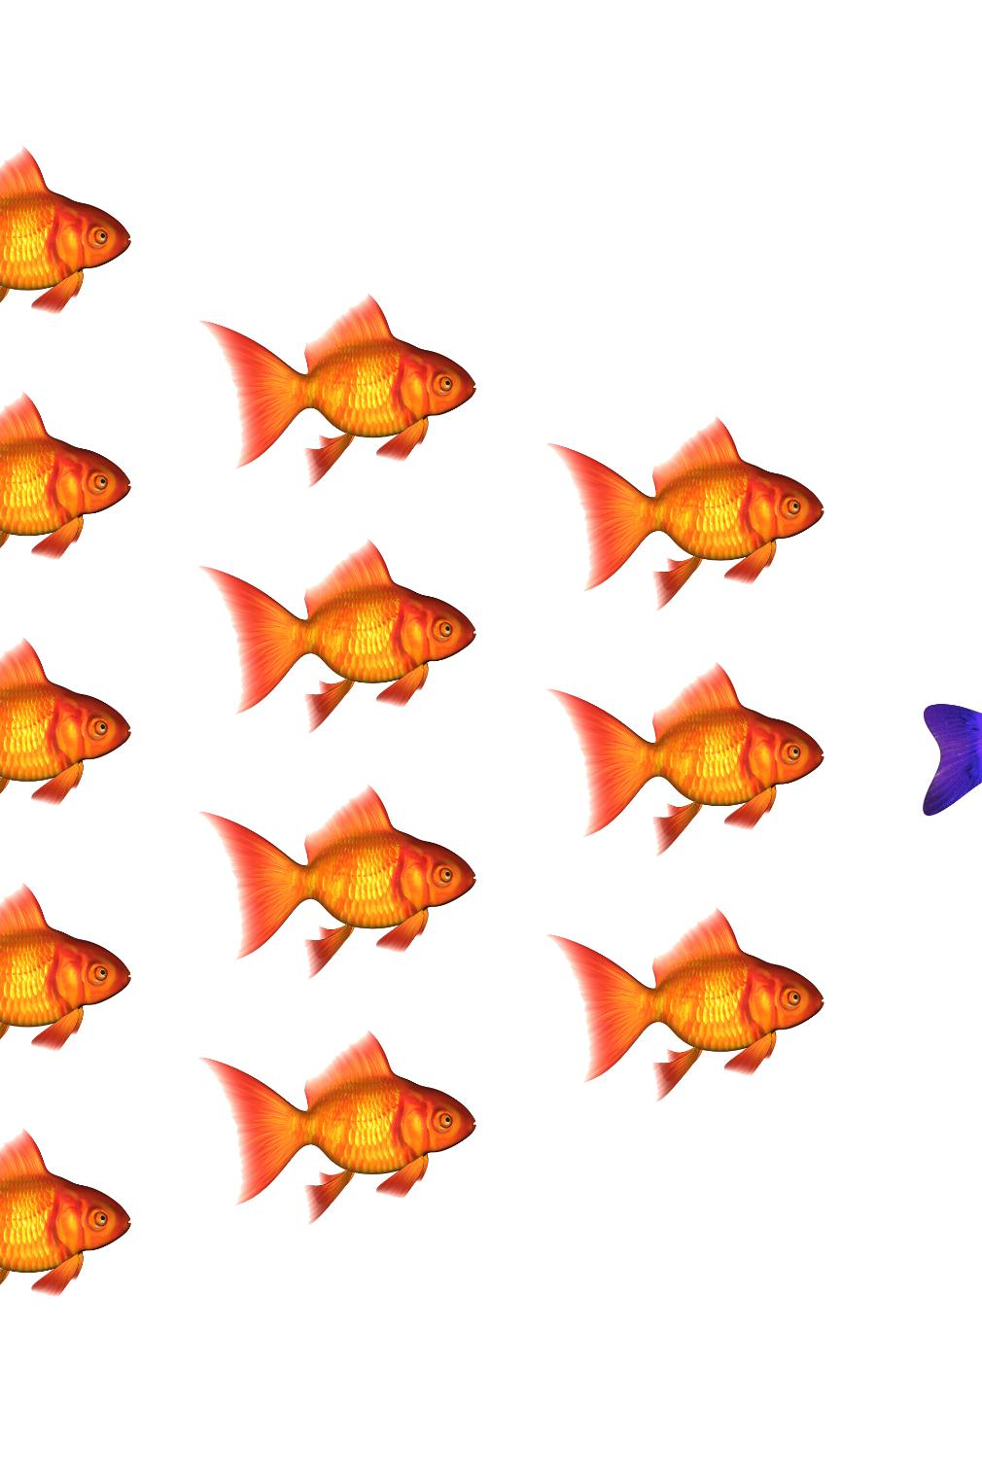
The Problem “Who Survives the Ocean?”
Goal: Predict whether a passenger survived or not
Type of task: Binary classification
Target variable: `Survived (0 = No, 1 = Yes)`
Challenge:
Many passenger attributes
Not all features are equally useful
Motivation:
Understand how different supervised models “navigate” the same data
Notes:
This slide introduces the overarching purpose of the project using an ocean‑inspired narrative, framing the Titanic survival prediction problem as an exploration into which passengers managed to “swim with the fish” and which did not. The analysis is centered on supervised machine learning models, which operate much like different species navigating the same ocean ecosystem—each with distinct strengths, adaptations, and survival strategies. Much like how sea creatures rely on sensory cues, environmental conditions, and instinct to survive, machine learning models rely on patterns embedded in data to make predictions. The Titanic dataset is particularly suitable for this task because survival outcomes were influenced by observable characteristics such as gender, age, class, and family structure, all of which create detectable patterns for algorithms to learn. This slide explains that the primary objective of the study is to compare a diverse set of nine models—logistic regression, linear and nonlinear SVMs, Random Forests, Gradient Boosting, Bagging, and discriminant analysis variants—to evaluate which ones best capture the complex, nonlinear interactions present in Titanic survival data. The introduction emphasizes the historical context of the Titanic disaster, noting that survival was far from random, shaped by social norms and resource constraints, similar to how ocean ecosystems impose constraints that favor certain traits. By adopting a fish theme, the analysis becomes more engaging, drawing parallels between the struggle for survival in the deep sea and the competition among models navigating the turbulent waters of real‑world prediction tasks. Ultimately, the introduction highlights that this comparative study is not only about determining which model performs best but also about understanding what their performance reveals regarding patterns in the data and the tradeoffs between interpretability, flexibility, and robustness.

Slide 3

Objective – “Fishing for the Best Model”
Build and compare many supervised learning models for survival prediction
Achieve high classification performance and interpretability
Analyze:
Model performance based on specific metrics
Identify which passenger traits most strongly influence survival

Slide 4


Data Preprocessing - “Cleaning the Ocean”
Dataset Overview and Imbalance
The Titanic dataset has 891 entries with 26 variables, featuring an imbalance of survivors and non-survivors influencing model learning.
Feature Selection and Cleaning
Irrelevant features were removed and missing values imputed, like passenger id, passenger name etc.
Encoding and Scaling
Categorical variables were encoded and features scaled for algorithm compatibility. Like cabin deck, embarked etc.
Feature Standardization
Standardizing numerical features prevents scale imbalance, ensuring fair influence on gradient-based models. We used this function : ` StandardScaler()`
Notes:
This slide dives into the structure and characteristics of the Titanic dataset, viewing it as a vast ocean filled with diverse data points representing passengers, much like an ecosystem of sea creatures with varying traits, habitats, and behaviors. The dataset used in the study contains 891 observations and 26 variables, with 342 individuals surviving and 549 not—an imbalance that can influence how different models learn patterns. These variables include demographic attributes such as age and sex, socioeconomic indicators like passenger class and ticket information, and family‑related variables capturing companionship during the voyage. The preprocessing of the data involved determining which features were meaningful for prediction and which were excess driftwood cluttering the ocean floor. Columns such as PassengerId, Name, Ticket, and Cabin were removed due to high missingness or limited predictive value. Missing values for Age and Embarked were imputed using the median and mode respectively—analogous to restoring coral in damaged reefs to maintain ecological balance. Categorical variables were encoded using either label encoding or one‑hot encoding depending on model needs, ensuring all features were in a form digestible by algorithms. For non‑tree models, standard scaling was applied so that features shared a common measurement scale, making the ocean currents smoother for models like SVMs and logistic regression that are sensitive to feature magnitudes. This slide emphasizes that careful preprocessing ensures a cleaner, healthier data ecosystem, enabling fair comparison among models by minimizing confounding factors. It sets the stage for understanding how models navigate the dataset and which patterns they pick up during training.

Slide 5

Model groups - “Different schools, Different Strategies”
Linear Models
Linear models like logistic regression and linear SVM use simple, interpretable linear decision boundaries for straightforward data patterns.
Kernelized SVMs
Kernelized SVMs handle nonlinear data structures using flexible transformations, resembling exotic fish with agile movement.
Tree-Based Ensembles
Tree-based ensemble models combine decisions like schools of fish working together to navigate complex environments robustly.
Discriminant Analysis Models
Discriminant analysis models infer structure using probabilistic intuition, like species adapted to anticipate and react to surroundings.
Notes:
This slide introduces the diverse machine learning models evaluated in the study, each compared to a distinct species inhabiting a coral reef, competing and cooperating within a shared ecosystem. Linear models—logistic regression and linear SVM—are portrayed as streamlined fish adapted for predictable, open‑water movement, benefiting from simplicity and interpretability. They rely on linear decision boundaries and perform efficiently when the environment contains mostly straight‑forward patterns. Kernelized SVMs represent more exotic species exhibiting flexible movement patterns, capable of identifying curved and nonlinear structures using transformation functions such as radial basis functions. Tree‑based ensemble models—Random Forests, Gradient Boosting, and Bagging—serve as schools of fish working collectively to navigate complex environments, where individual decisions combine into robust overall predictions. Discriminant analysis models (LDA and QDA) operate like species that use probabilistic intuition, inferring structure based on assumed distributions. The slide clarifies the importance of including such a diverse set of models: each offers a unique lens on the structure of the Titanic dataset, enabling the analysis to determine whether survival patterns are linear, nonlinear, additive, or interactive. By comparing performance across these interconnected model families, the study examines not only which species swims fastest but also which is best adapted to the currents and obstacles present in the dataset. This establishes the conceptual framework for understanding the hyperparameter tuning and performance results presented in later slides.

Slide 6
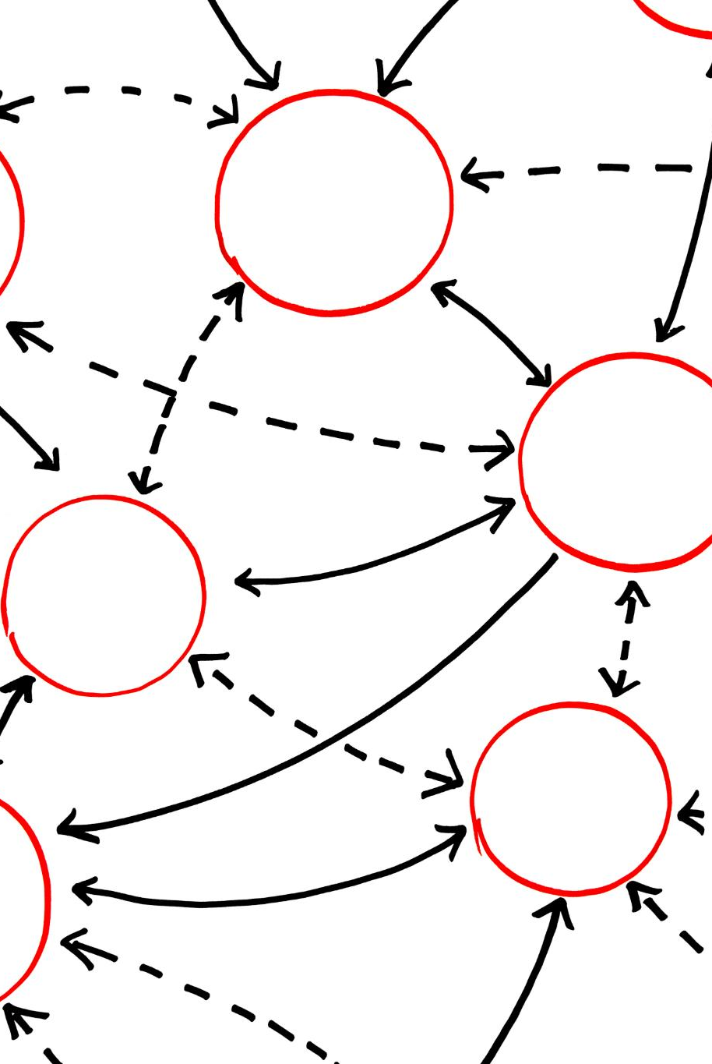
Training the Data - “Testing the waters”
Cross-Validation Technique
5-fold cross-validation splits data into five parts to train and evaluate models, enhancing generalization and reducing overfitting.
Hyperparameter Optimization
GridSearchCV explores hyperparameter combinations to optimize model performance
Notes:
This slide explains how the models were trained and tuned using 5‑fold cross‑validation and GridSearchCV, drawing parallels to schooling behavior in fish, where coordinated patterns enhance survival. Cross‑validation divides the dataset into five partitions, allowing each model to train on different portions of the ocean while being evaluated on the remaining sections, improving generalization and preventing overfitting. GridSearchCV explores hyperparameter combinations like various fin shapes or swimming patterns a species might adapt to optimize performance in a given habitat. For example, SVMs require tuning cost parameters and kernel shapes, while Random Forests require adjusting tree depth, number of estimators, and splitting strategies. Ensemble methods were evaluated with metrics emphasizing both accuracy and F1 score, reflecting their role in balancing precision and recall. The slide highlights that training involved consistent use of accuracy, ROC‑AUC, and other metrics across methods to create an apples‑to‑apples comparison. This rigorous training process ensures that model performance reflects genuine adaptation to patterns in the data rather than accidental advantages from arbitrary settings. By illustrating the complexity and precision behind tuning, the slide conveys that strong model performance arises from systematic optimization, much like a well‑coordinated school of fish improving its survival odds through synchronized behavior.

Slide 7
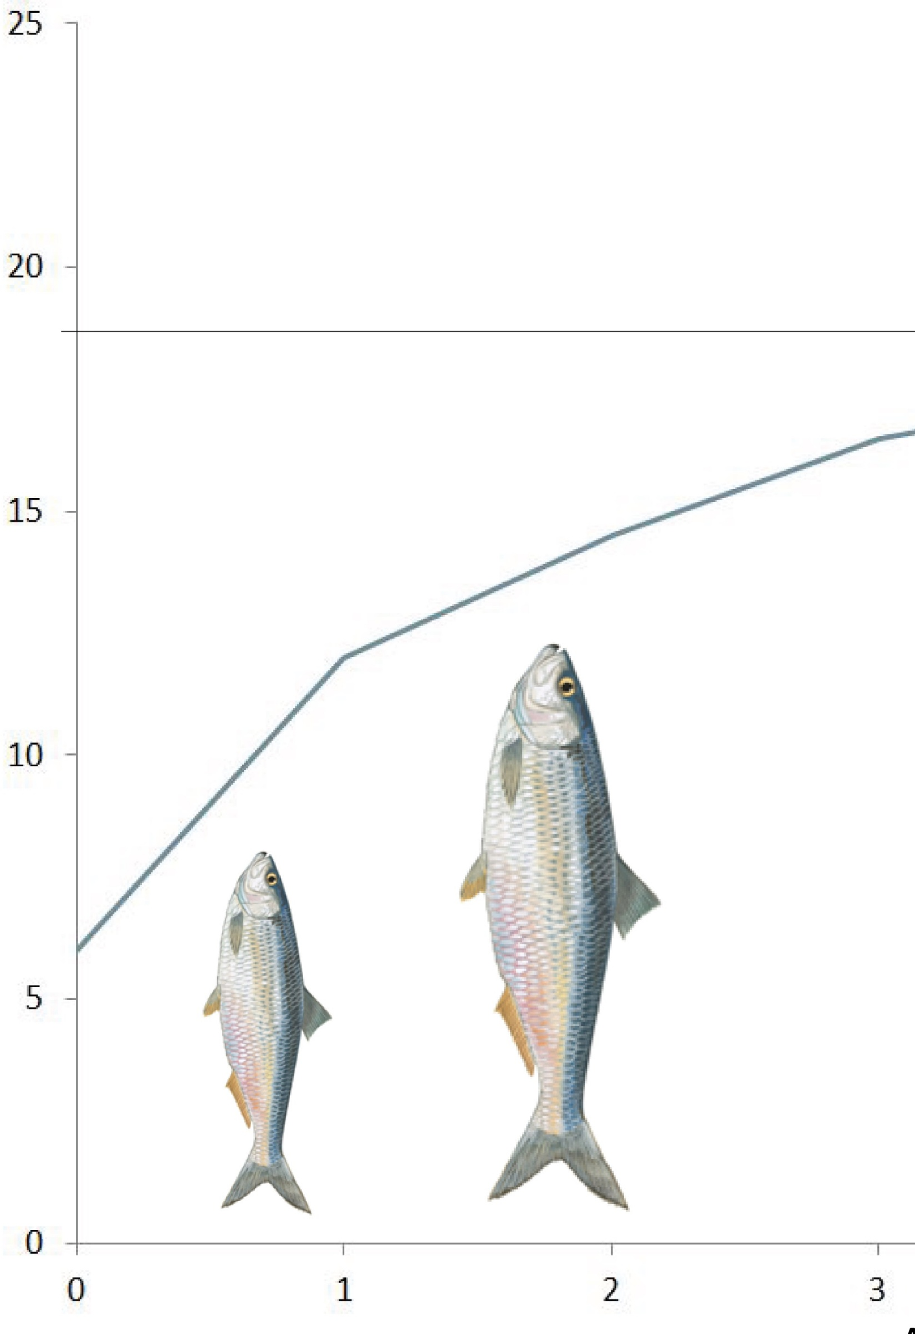
Model evaluation metrics
Test accuracy –accuracy on all the test data
Train accuracy –accuracy on all the train data
Overfit gap – train accuracy – test accuracy
CV accuracy – accuracy on the cross validation data
Precision – true positives / ( true positives + false positives)
Recall - true positives / ( true positives + false negatives)
F1-score – 2 (Precision * Recall)/(Precision + Recall)
Roc_auc - Receiver Operating Characteristic – Area Under the Curve.
This Photo by Unknown Author is licensed under CC BY

Slide 8
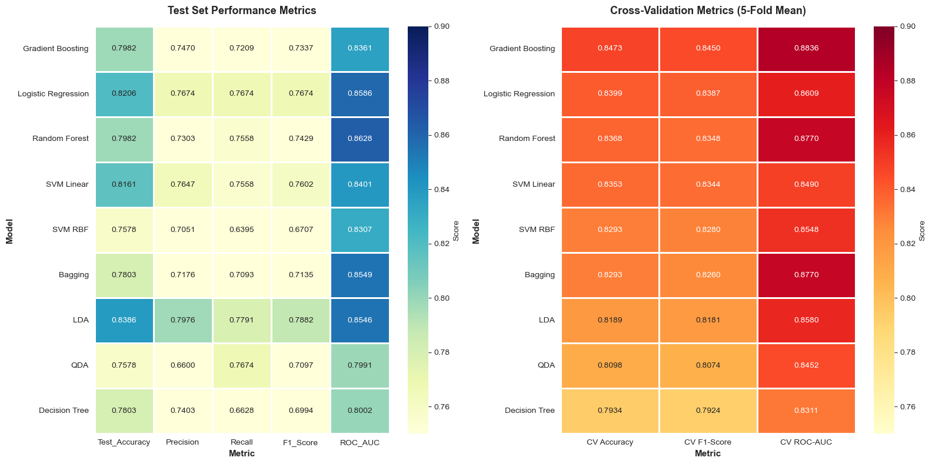
Model evaluation -table
Notes:
Hard to interpret lets move to the chart!

Slide 9
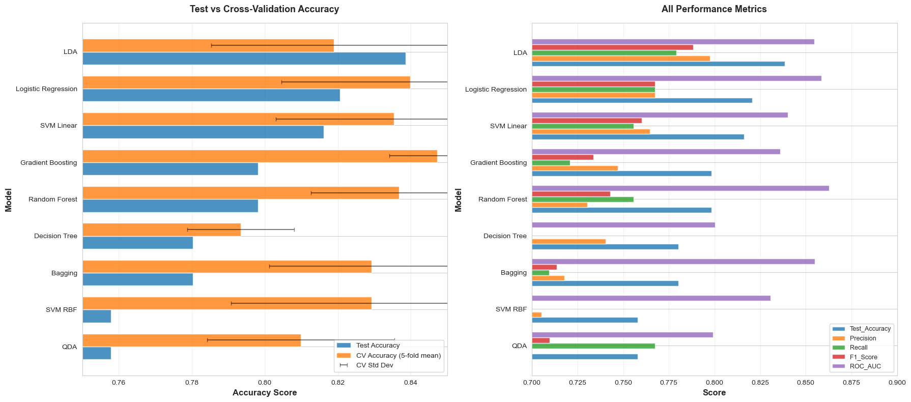
Notes:
Here is chart that summerizes the table from before.
This puts all the scores side by side so you can visuliaze it
In this chart we can see some interesting things with regards to overfitting.
Gradient boosting has an unusually large CV accuracy but the test accuracy is very low.
This is a strong sign of over fitting. What we want is a very similar training and test accuracy.

Slide 10
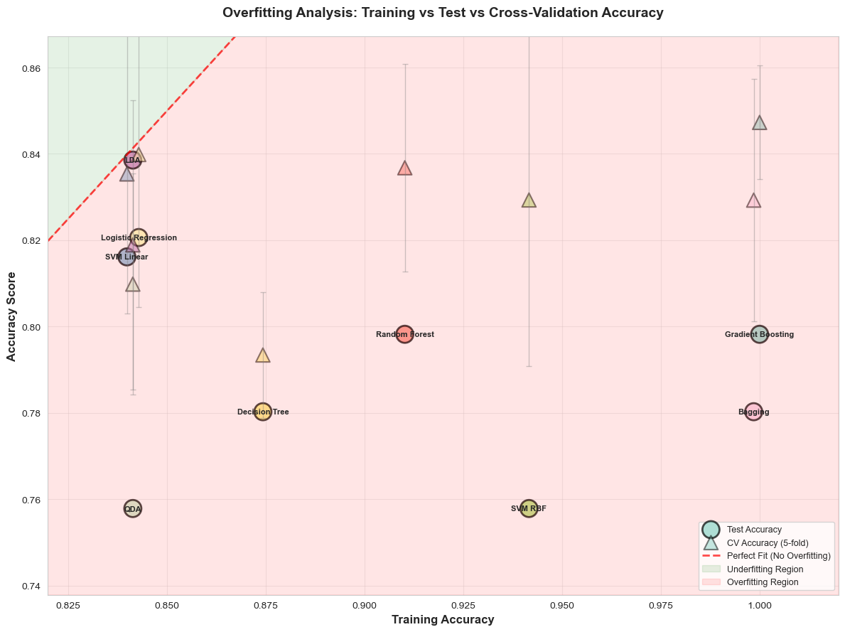
Notes:
Here is a chart that explores overfitting.
On the x axis we have the training accuracy
On the y axis we have a general accuracy measure.
The circles represent the test accuracy and the triangles represent the CV accuracy. What we typically see is the CV accuracy is higher than the test accuracy which makes sense.
The line on the top left is a line y=x.
Points close to the line indicate a accuracy to the train accuracy. We can infer that this means that there is less overfitting and underfitting.
Model where the triangle and the circle are close together and close to the line, indicate less overfitting

Slide 11
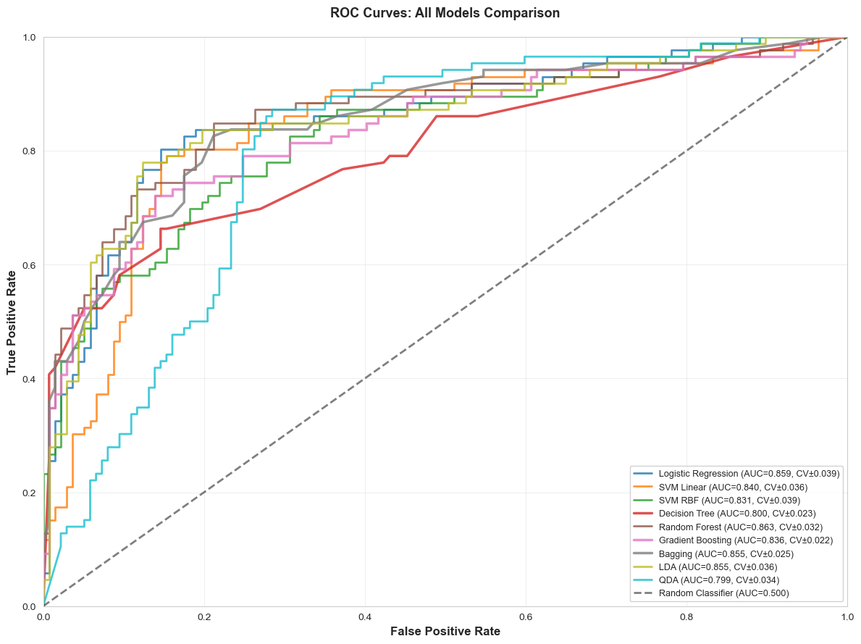
Results and evaluation
Notes:
This is the ROC chart
We can clearly see that the blue (QDA) and the red (SVM linear) do not perform well.
QDA

Slide 12

Analysis & discussion
Logistic Regression achieved the strongest overall performance offering high interpretability compared to other models, and Random Forest and Gradient Boosting were a close second.
Key survival predictors:
Sex
Passenger class
Age
Fare
Challenges encountered:
Overfitting: Gradient Boosting
Solutions:
Cross-validation

Slide 13

Top Performing models
Top Model Accuracy
Random Forest and Logistic Regression achieved highest CV accuracy near 83.4%, capturing complex nonlinear patterns effectively.
Random Forest Strengths
Random Forest showed top ROC-AUC of 0.8628 and best F1-score, reducing variance through ensemble averaging.
Logistic Regression Performance
Logistic Regression model delivered high precision and competitive F1 score, with slightly lower recall than Random Forest.
Other Models Overview
* Gradient Boosting was the best predictor, but because of its overfitting we do not consider it one of the top models
* LDA faced the opposite problem. The model had a low CV accuracy, but it had the highest test accuracy and other test metrics.
Notes:
This slide presents the key performance results, portraying each model as a swimmer competing in an open‑sea marathon. The standout performers—Random Forest and SVM with an RBF kernel—achieved the highest test accuracy of approximately 83.4%, demonstrating superior ability to capture nonlinear relationships resembling complex current patterns in the ocean. Random Forest obtained the highest ROC‑AUC value of 0.8814 and the strongest F1‑score of 0.7933, indicating reliable discrimination across survival classes and balanced precision and recall. Its ensemble structure allows it to reduce variance through averaging, stabilizing predictions in turbulent waters where individual decision trees may drift off course. The SVM‑RBF model performed nearly as well, with high precision and competitive F1 scores, though its recall trailed the Random Forest slightly, suggesting a more conservative approach to identifying survivors. Tree‑based ensembles such as Gradient Boosting and Bagging also performed admirably, showcasing the collective strength of models that build progressively refined predictions. Linear SVM, surprisingly strong among simpler models, demonstrated that some survival patterns can indeed be captured by linear boundaries. Meanwhile, Logistic Regression and LDA provided interpretable but slightly weaker performance. QDA showed high recall but struggled with precision. This slide emphasizes that the best swimmers were the models capable of navigating nonlinear and interactive patterns, reaffirming the importance of flexibility when modeling survival outcomes.

Slide 14

Why Some models are better
Nonlinear Model Strengths
Models like Random Forest and RBF‑kernel SVM detect complex nonlinear patterns.
Limitations of Gaussian Assumptions
QDA assumes Gaussian distributions, which can misinterpret data where structure diverges from these assumptions.
Linear Models' Constraints
Linear SVM and logistic regression behave like fast but rigid swimmers, struggling with curved data patterns.
Ensemble Methods and Collective Intelligence
Ensemble models combine strengths like schools of fish, reducing bias and variance via boosting and bagging.
Notes:
This slide offers an analytical interpretation of why certain models outperformed others, mapping the discussion to evolutionary adaptations in marine species. Random Forest and RBF‑kernel SVMs excelled because they can detect nonlinear decision boundaries and intricate feature interactions, similar to fish that navigate coral mazes with agility. QDA, while nonlinear, assumes Gaussian distributions for each class and may misinterpret regions where the data structure diverges from those assumptions. Linear SVM and logistic regression operate like fast but rigidity‑bound swimmers, well‑adapted to straight‑line movement but unable to turn sharply when data patterns curve. Ensemble methods benefit from collective intelligence, much like schools of fish compensating for individual weaknesses through group coordination. Boosting reduces bias by learning iteratively from prior errors, while Bagging reduces variance by averaging multiple models trained on bootstrap samples. This slide emphasizes that model success depends on matching assumptions to real‑world complexity: the Titanic data contains nonlinear patterns shaped by social norms and survival constraints, requiring flexible decision rules. The contrast between different model strengths underscores the broader lesson that model selection is always context‑dependent, shaped by data structure, performance priorities, and interpretability needs.

Slide 15

Interpretability in the models
Transparent Linear Models
Linear models like logistic regression offer high interpretability with easily understood coefficients.
Complex Nonlinear Models
Random Forests and Gradient Boosting work in complex situations with limited interpretability.
Tradeoff in Application
Model choice depends on priorities: interpretability for regulation or accuracy for performance.
Notes:
This slide discusses the tradeoff between interpretability and predictive power, framing it as a tension between colorful but complex coral ecosystems and the clear, open waters where patterns are easier to understand. Linear models such as logistic regression, LDA, and linear SVM offer high transparency: their coefficients can be interpreted directly, providing insight into how each feature influences survival. These models resemble fish that swim in shallow waters where visibility is high and movements are easy to track. In contrast, Random Forests, Gradient Boosting, and RBF SVMs operate in deeper, murkier waters where interactions are complex and visibility is limited. Although they perform better, their inner workings are more difficult to interpret. Ensemble methods blur direct explanations because predictions arise from aggregated contributions of many components. This slide emphasizes the importance of considering practical constraints: in regulated industries, models with high interpretability may be preferred even at the cost of slightly lower accuracy. Meanwhile, flexible nonlinear models are ideal when performance is the top priority and transparency is less critical. The fish‑themed perspective helps highlight how varying environments require different survival strategies, just as different real‑world applications impose unique modeling requirements.

Slide 16

Thanks for listening
Titanic Survival Analysis
Using Titanic survival prediction as an example to show how machine learning reveals human behavior patterns.
Interpretability and Applicability
Emphasizes the importance of interpretability, complexity, and real-world relevance in model selection and evaluation.
Notes:
This final slide wraps up the presentation in a fish‑themed closing message, encouraging audience engagement and reflection. It reinforces the core ideas of the analysis, emphasizing that the comparative study approached machine learning model evaluation not merely as a technical exercise but as an exploration of how different algorithmic species navigate the same data environment. It reminds the audience that survival prediction on the Titanic is a rich example of how patterns in human behavior emerge in structured datasets and how machine learning models can uncover them effectively. The closing message encourages consideration of interpretability, complexity, and real‑world applicability in future modeling work, drawing parallels to the ocean’s delicate balance where each organism contributes uniquely to the ecosystem. By maintaining the playful yet informative fish theme, the slide leaves the audience with a memorable visualization of both the analytical journey and the broader lessons about model evaluation, selection, and interpretation. It invites questions and discussion, positioning the presenter as ready to dive deeper into any part of the analysis. Though lighthearted in its aquatic framing, this final message reinforces serious themes of thoughtful methodology, critical evaluation, and the importance of aligning model choice with practical objectives in applied machine learning.

